Slide 1

INFO 6068 Capstone Project
Testing Ewheelz Web Application – Test Cases
Professor:
Kim Gariepy
Members:
Daniel Gilbert
Mrinal Chopra
Lyan Joy Limjap
Francisco Gomez
Ralph Anonuevo
Rose Maria George

Slide 2
Agenda
01
Introduction
02
Timeline
03
Modules (Use Case, Test Case, Traceability Matrix)
04
Test Tool and environment
05
Documents Test Data

Slide 3
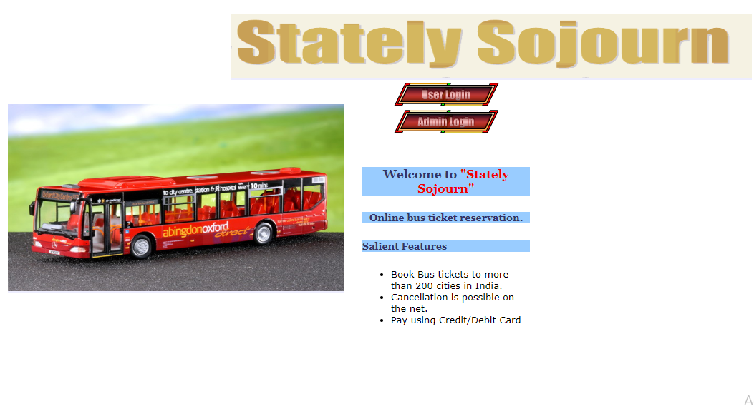
Team Pro-Test: Who We Are
We are a Top-Tier
Professional Software Testing Team
We have a strong commitment to the proper evaluation of software systems. We seek to improve any software product we test by achieving defect prevention and usability problem resolution using functional and non functional testing approaches. We guarantee the best performing products that fulfill all the requirements of our customers.
We have been hired to test Stately Sojourn’s Travel and Tourism web page. The system allows users to View available Bus Routes, Pick-up points and associated Travel Agencies; allows them to book and cancel Bus tickets; and allows them to Give and View Testimonials

Slide 4


Where We’re at So Far
Moving Forward
Use Cases Created to Cover all requirements
Test Cases covering every possible path of Use Cases
Test Cases to make sure all requirements are covered
Up to this Point
The team was assembled, and roles were assigned
The team reviewed the project requirements
We developed a Test Strategy and a Test Plan to define our testing procedure

Slide 5
Timeline project
Week 1
Week
2-3
Week 4-6
Week 5-7
Week 8-9
Week
9
Week 10
Initiation
Create Test Cases
Final Reporting /Project Closure
Create Team
Assign Roles and Responsibilities Conduct Preliminary Research
Test Execution
Define tests that cover all conceivable Use Cases
Identify Key Conclusions of Project
Report key findings to Stake Holders
Create Test Scenarios/Scripts
Conduct Testing
Functional Testing
Usability Testing
Automated Testing
Two Phases
Planning
Define Scope
Create Test Plan
Create Test Strategy
Create Persons to represent key user bases
Create Scenarios that represent bulk of usage
Create Scripts to structure testing
Execution Reporting
Analyze and Synthesize results of testing

Slide 6
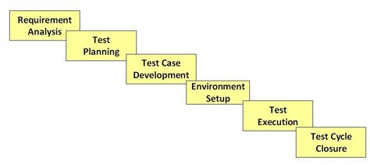
Software Testing Lifecycle Phases
Test Case Development
Use Case Development : Modelling possible sequences of interaction between User and the System in order to identify, clarify and organize requirements
Test case development : A set of conditions under which the system will be tested in order to determine if the actual results match the expected results and thus if the system is meeting requirements.
Requirements Traceability Matrix: Maps Test Cases to Use Cases to ensure that all requirements have been tested and that all Test Cases are purposeful
Picture1 - Picture taken from: STLC - Software Testing Life Cycle Phases & Entry, Exit Criteria. (2019). Retrieved from https://www.guru99.com/software-testing-life-cycle.html

Slide 7
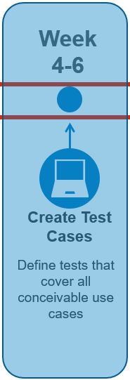
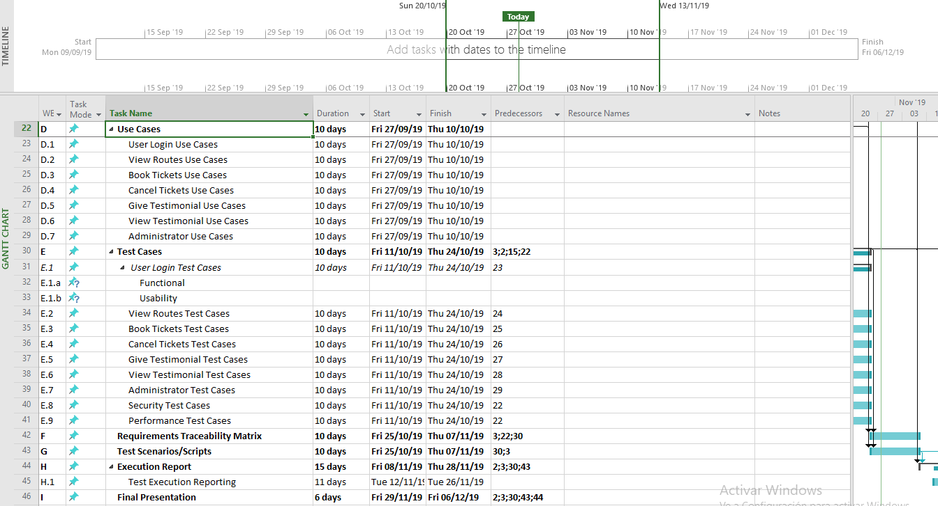
Project Timeline

Slide 8
Reviewing Requirements
ADMINISTRATOR MODULE:
This module provides administrator related functionality. Administrator manages all information and has access rights to add, delete, edit and view the data related to places, travels, routes, bookings, etc. Admin also need to be able to Login
TRAVELS MODULE:
This module provides the details of various travel agencies. A user can select the appropriate agency depending on convenience and accessibility.
ROUTES MODULE:
This module provides information related to various routes connecting sources and destinations. For each route, information such as source, destination, fare, reservation details, pick up points etc are provides. Only administrator can add, delete, edit and manage the data. Users can only view the information.
RESERVATIONS MODULE:
This module provides functionalities that allow a user to book tickets or cancel previously booked tickets. The module maintains the details of all reservations made so far and allows administrator to either confirm or reject the bookings.
TESTIMONIALS MODULE:
Users of this application can post their opinions, complaints and suggestions regarding this portal and services to the administrator. Accordingly, the administrator can take various steps to act on the complaints and suggestions.

Slide 9
Requirements Continued
User Module:
User needs to be able to log in / log out and access all the other modules available to them
Hacker Module:
This module provides the details of various travel agencies. A user can select the appropriate agency depending on convenience and accessibility.

Slide 10
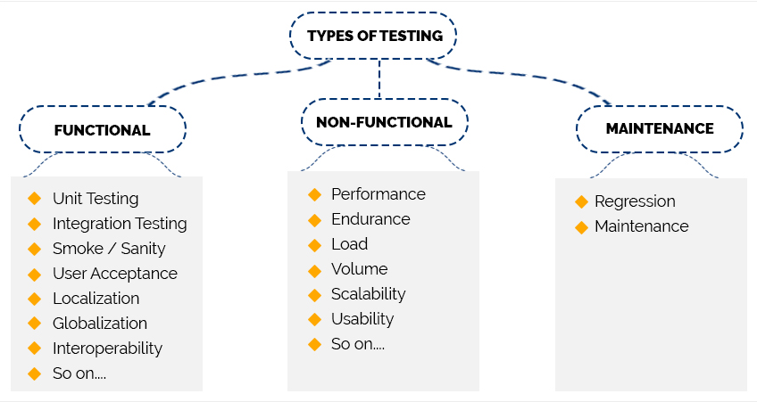
Lets do it our test cases!

Slide 11
Agenda
02
Time line

Slide 12
Agenda
03
Modules (Use Case, Test Case, Traceability Matrix)

Slide 13
Modules vs Test Types
Modules / Test Types
User
Reservation
Functional
The system is tested to ensure that it operates in the intended ways. And allows user to perform intended tasks
Usability
The system is tested to determine how well users are able to utilize it. How effectively and efficiently can users accomplish tasks and how satisfied they are with the experience
Routes
Travel
Security
The system is tested to ensure it is free from flaws and vulnerabilities that could result in loss of data or functionality
Administration
testing technique performed to determine the system parameters in terms of responsiveness and stability under various workload.
Compatibility
Evaluate that the application is compatible with others hardware and software configuration.
Evaluate that the user have high compression and understanding form the information provide by the website
Performance
Design
Testimonials
Hacker

Slide 14
Functional test cases
Modules / Test Cases
User login
Reservation
Routes
Travel
Administration
Functional Test Cases
This section considered cases like Positive and negative user login / user logout / Change Password
This part take account Positive and negative login and logout routes section and pickup point section
This testing case include positive , negative and exception in the case to access in the travel menu
This part take account Positive and negative login and logout routes section of book tickets
Administration section include positive and negative scenarios to create , delete , modify user accounts

Slide 15
Usability test cases
Modules / Test Cases
User login
Reservation
Routes
Travel
Test Cases
This section considered cases like efficiency, accessibility login user in the website
This part take account efficiency, accessibility to view routes.
This testing case include efficiency , satisfaction to Give or view testimonials
This part take account efficiency, accessibility to book tickets , created and erased.

Slide 16
Security test cases
Modules / Test Cases
Administration
Test Cases
This section considered cases like injection SQL to avoid external access in the principal database of the system

Slide 17
Performance test cases
Modules / Test Cases
User login
Reservation
Routes
Travel
Administration
Test Cases
This section considered cases like click , log in load test from the user in the website, also cases of volume data to check the maximum capacity of the system
This part take account speed metrics to login and logout routes section and pickup point section
This testing case include cases to test the speed and time or responds to access in the travel menu
This part take account testing the speed in the web site in process like login and logout routes section and book tickets
Administration section include scenarios to verify the speed to create , delete and modify user accounts

Slide 18
Compatibility test cases
Modules / Test Cases
Administration
Test Cases
This section considered cases like run the application in different software browser to analysis the behavior of this application

Slide 19
Design test cases
Modules / Test Cases
Administration
Test Cases
This section considered cases to evaluate the fonts , size, color of the web site to determine the level of compression of the user that user this application.

Slide 20
Agenda
04
Test Tool and environment

Slide 21




Test Tools
Selenium IDE
SQL scripting
For running automated functional testing of large quantities of data.
For load testing with large quantities of data as well as database sanitization
JMeter
Wireshark/BSQL Hacker
For testing performance of the system.
Emulating large quantities of users in different scenarios. .
Security Testing Tools for monitoring network security and database security respectively

Slide 22




Test Management Tools
Microsoft Project
Microsoft Word
For managing Test Plan, monitoring progress on deliverables, displaying connections and creating a Gantt Chart
For managing Test Strategy Document as well as Scripts, Scenarios, Personas and Questionnaires for testing
Excel
Google Drive
For managing test cases and results as well as IAD log, team roles and the CSV documents produced by automation tools
Used for document versión control and keeping all team members up to date

Slide 23
Agenda
05
Documents Test Data

Slide 24
Documents output
Use Case:
Use Case Testing is defined as a software testing technique, that helps identify test cases that cover the entire system.
Test case:
is a set of conditions or variables under which a tester will determine whether a system under test satisfies requirements to works correctly
Traceability Matrix:
it is a document that maps and traces user requirement with test cases

Slide 25
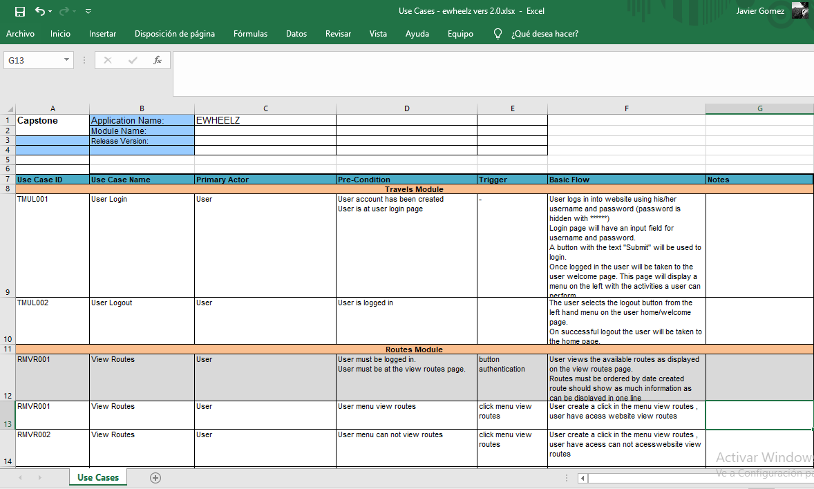
Use case output
Columns | Description
Use case ID
Use case Name
Primary Actor
Pre condition
Trigger
Basic Flow
Notes

Slide 26
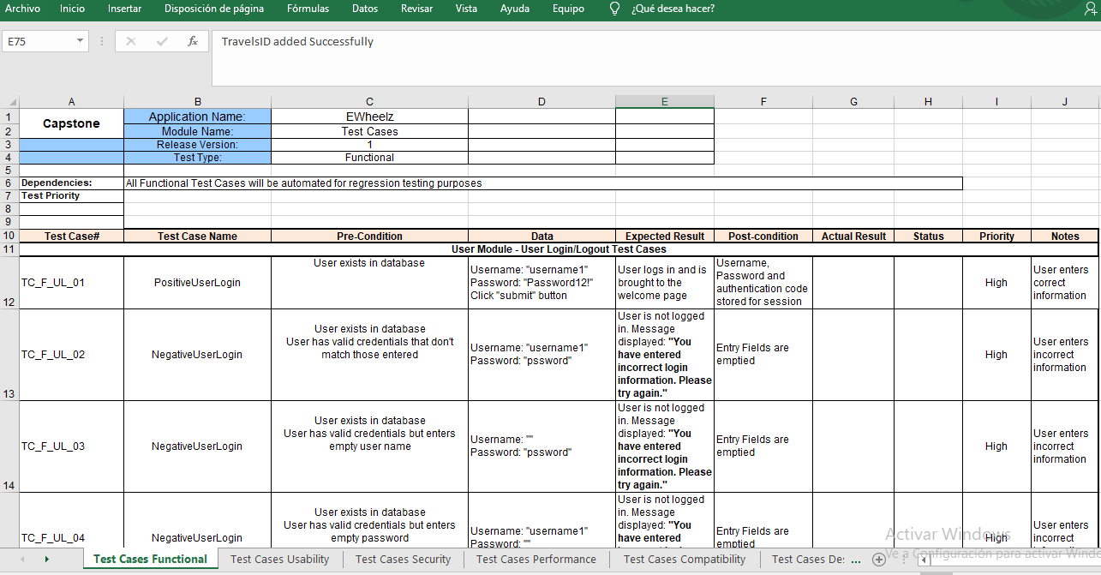
Test case output
Columns | Description
Test case Number
Test case Name
Pre condition
Data
Expected Result
Post condition
Actual result
Status
Priority
Notes

Slide 27
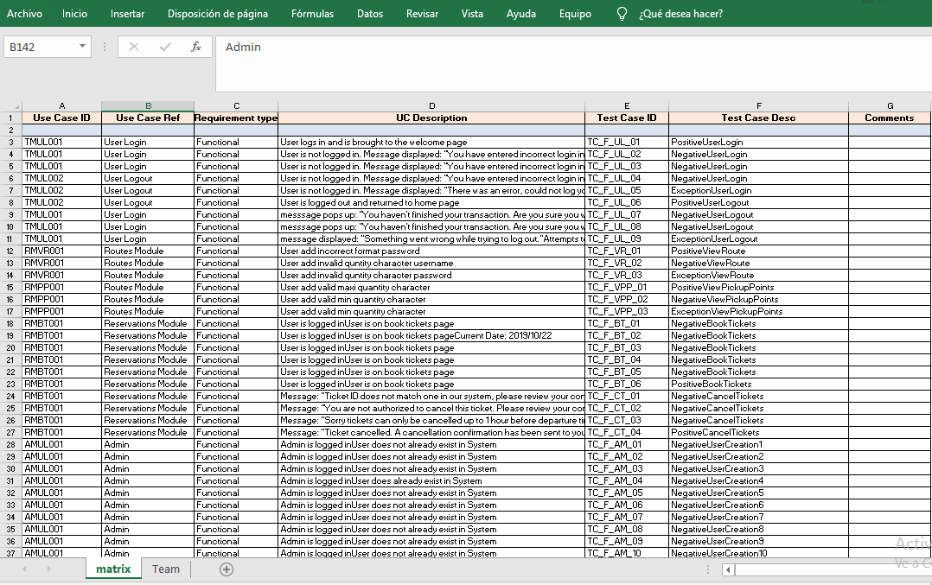
Traceability Matrix output
Columns | Description
Use case ID
Use case Ref
Requirements type
UC description
Test case ID
Test Case Description
Comments

Slide 28
Thank You

Slide 29
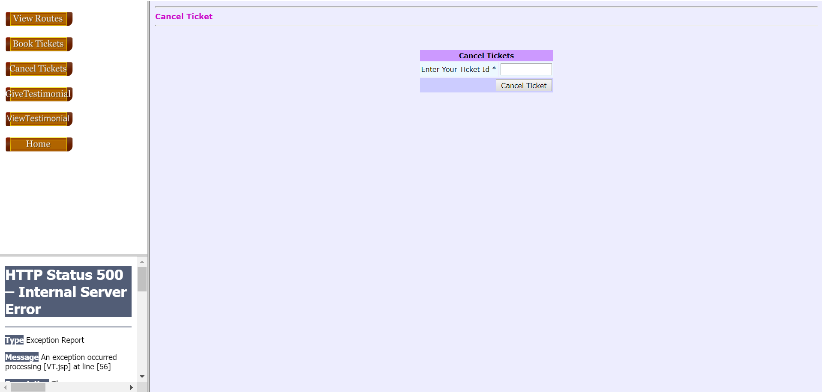
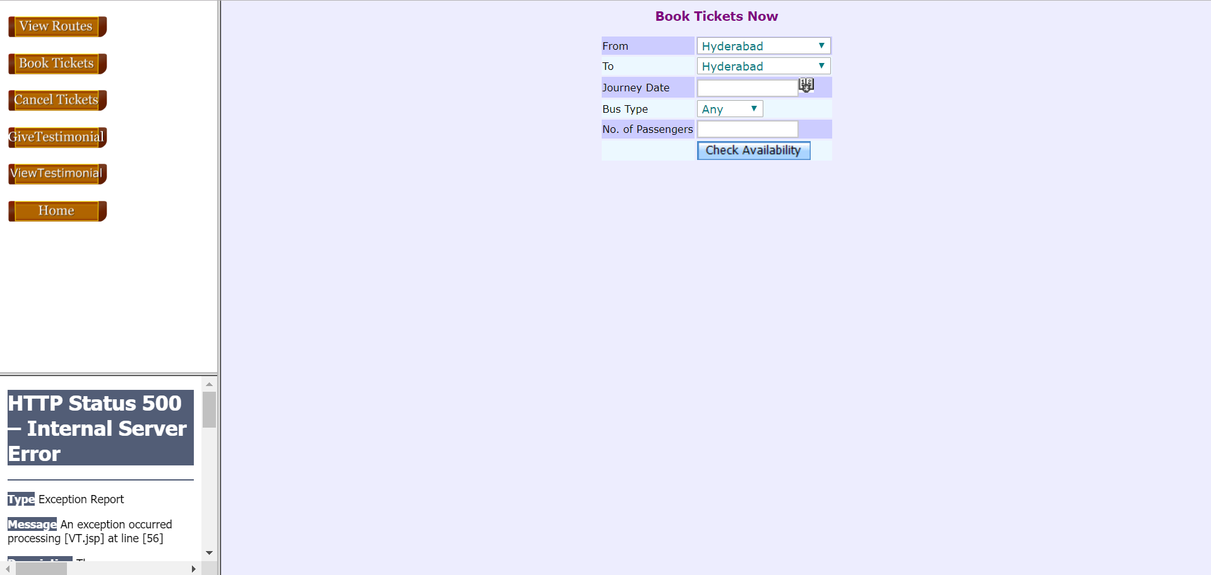

Slide 30
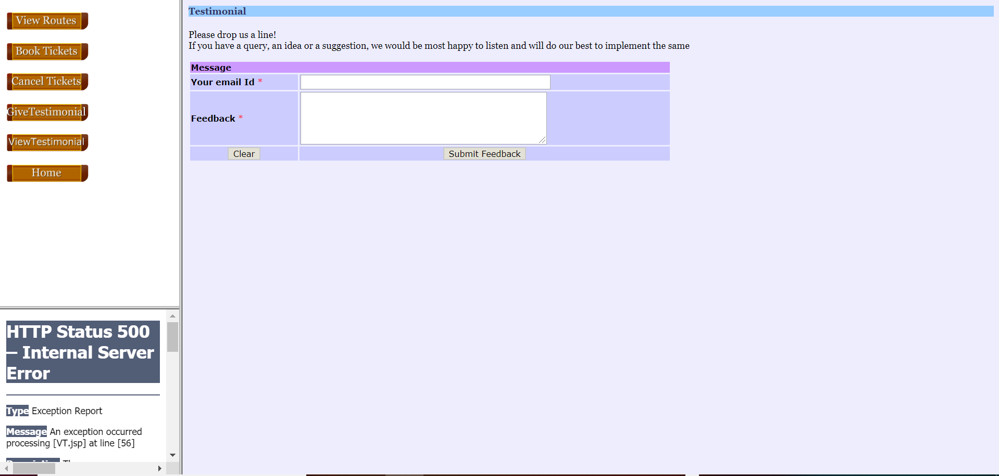

Slide 31
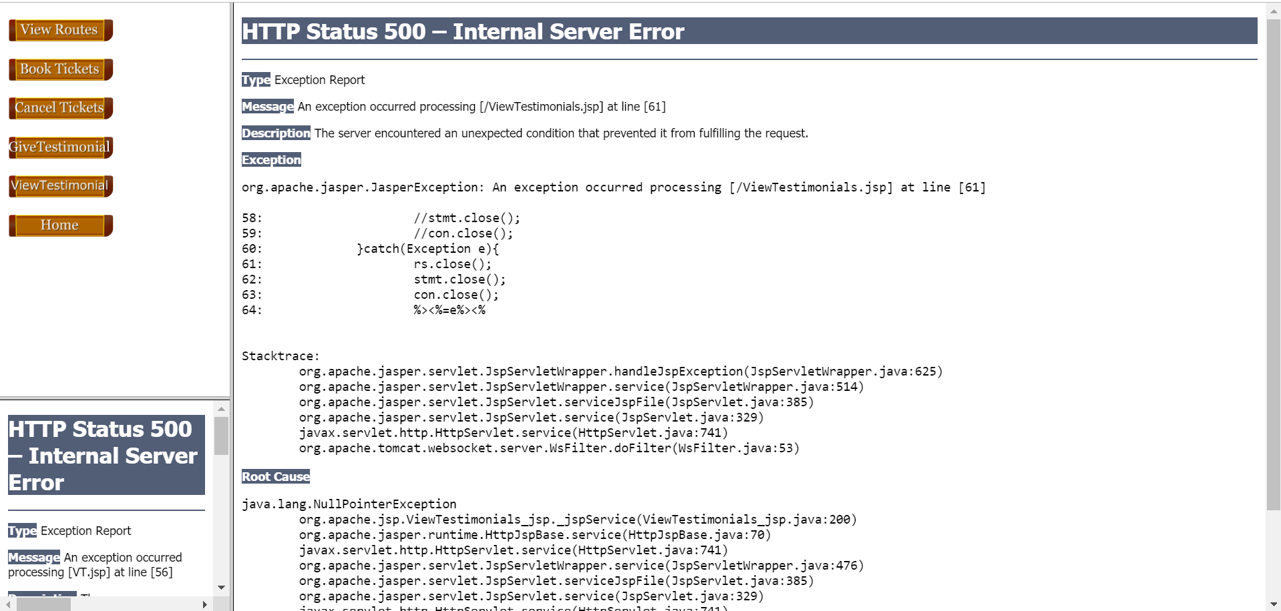

Slide 32
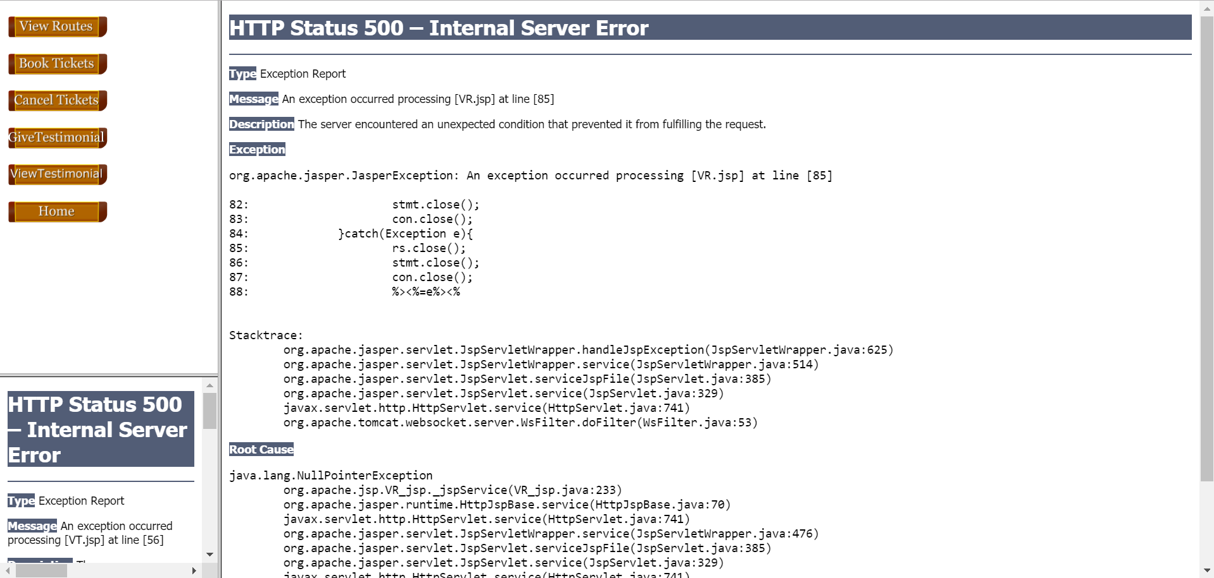

Slide 33
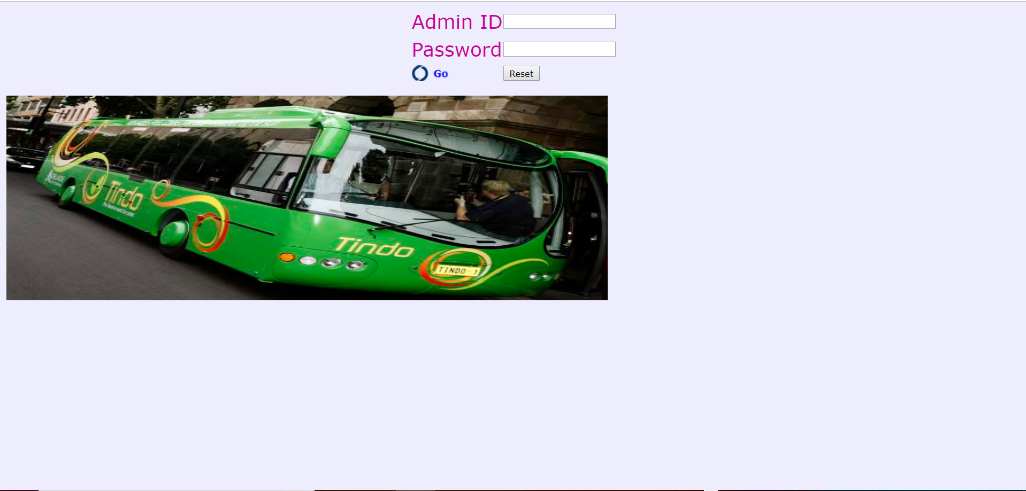

Slide 34
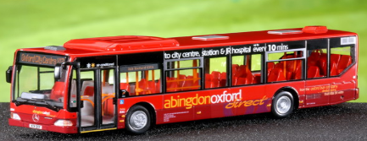
Roles And responsibilities
Project Manager
Responsible for conducting project meetings, update the project status to the professor and ensuring the project moves forward as per the project plan. This role will be rotated weekly
report
Technical lead
Responsible for installation and setup of the test environment, maintaining all the tools and ensuring they are working properly
Ewheelz App
Quality Analyst
Input
conclusion
Responsible for ensuring standards of every milestone through the project and verification of every document created. This role will be rotated for each milestone.
Test Analyst
Responsible for designing, implementing and executing test cases, scenarios and scripts. This role will be taken on by all members of the team in conjunction.
output
Scribe / Workshop session
Responsible for taking down the meeting minutes, meeting agenda, submissions and maintaining the IAD log. This role will be rotated weekly

Slide 35
Test Execution Roles
Daniel Gilbert, Mrinal Chopra and Anand Baby will be head of Functional Testing. Functional Testing will be conducted first to ensure system is functional enough to stand up to other forms of testing. Functional testing will occur during both phases of testing.
Francisco Gomez and Rose George will be head of automated testing. Automated Testing will be done in the first phase provided the system is functional enough to handle it. If not, automated testing will have to be conducted in phase two. The Smoke Test will help determine this.
Ralph Anonuevo and Lyan Limjap will be head of Usability Testing. Usability Testing will be conducted only in the second phase of testing once the system has been made functional enough for users to test.

Slide 36
Testing Overview
Water fall model
Development Lifecycle
The team will utilize a Waterfall Software Development Lifecycle approach for our testing.
Waterfall makes the most sense for this project because the testing team does not have the opportunity to work in conjunction with the development team
the team is being given all the components at once rather than each component individually as it is developed
Planning
Analysis
Design
Implementation

Slide 37


Preliminary Steps
To start the testing process the team will first review all Functional and Non-functional Requirements
The team will then proceed with Smoke Testing which is a series of non-exhaustive tests the ensure the most important functions work and that the system is stable enough to proceed with further testing

Slide 38
Test Execution / Types of Testing
Functional Testing
Boundary Value Analysis and Equivalence Partitioning for entries within menus
Component, Integration, System and Acceptance Testing
Regression Testing for second phase, after update
Automated Testing
F
AT
Automated Testing will be done to test that the system is meeting performance criteria (System handles 3500 users at a time and renders a page in under 3 seconds).
Jmeter and Selenium will be used for automated testing.
Listeners will be created to test all the menus and facilities of the app.
Usability Testing
Morville`s Honeycomb Model will be utilized to structure a Heuristic Evaluation for Usability Testing
Scenarios representing most frequent use cases will be created
Personas will be created to identify key user base to select testers
Ten people matching persona criteria will be selected for usability testing
U
S
Security Testing
Wireshark will be utilized to test network security
BSQL Hacker will be utilized to test SQL database security
.

Slide 39
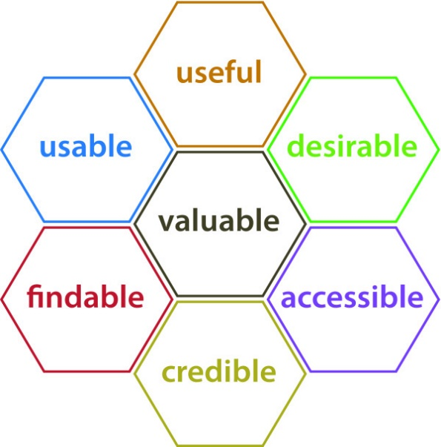
Heuristic Evaluation: Morville’s Honeycomb Model
Morville’s Honeycomb Model was chosen for the Usability Testing of this system as it covers all the major bases of the User Experience and applies well to web applications like Ewheelz
Useful: The product should fulfill a need. Usable: The product should be easy to use. The product should help the user accomplish their desired goal.
Desirable: The visual appearance of the product should be enjoyable. The design should be minimal and to the point.
Findable: Content should be navigable and locatable. The navigational structure of the website should make sense.
Accessible: The product should be designed in such a way that those with disabilities can have an equally positive experience
Credible: The product needs to be trustworthy and reliable.
Picture 2 - Picture taken from: Rosenbaum, Sarah & Glenton, Claire & Cracknell, Jane. (2008).
User experiences of evidence-based online resources for health professionals: User testing of The Cochrane Library. BMC medical informatics and decision making. 8. 34. 10.1186/1472-6947-8-34.

Slide 40
Entry and Exit Criteria
Type of Test | Entry Criteria 1 | Entry Criteria 2 | Entry Criteria 3 | Exit Criteria 1 | Exit Criteria 2 | Exit Criteria 3
Functional | Business and technical Requirements defined | Environment Set up | Test Cases and Test Plan defined | All Test cases executed | All defects documented and reported | Severity Codes assigned
Usability Testing | Metrics defines | Scenarios and Personas created | Testers selected and scripts written | All testers complete tasks and questionnaires | All relevant information consolidated and analyzed | Severity Codes assigned
Automated Testing | All automatable test cases identified | Jmeter and Junit scripts created | Required parameters defined (3500 users at a time, load page in under 3 seconds) | 100% of test cases executed and results recorded | Output reports generated by automation tools and analyzed | Severity Codes assigned
Security Testing | Security Standards established | Security Risks identified | Security Testing Tools and Protocols Selected | Vulnerabilities identified and addressed | Minimum security standards met and exceeded | Security risks mitigated

Slide 41
Test Data
Test Type | Source of Test Data
Functional Testing | Manually generated using boundary value analysis and equivalence partitioning. Exception cases will also be manually identified
Automated Testing | Ranges of values will be provided to the automated testing tools.
Usability Testing | Scenarios and scripts will be created to organize the usability testing process Post-task and Post-Test Questionnaires will be used to record testing results
Security Testing | Known Vulnerabilities, Penetration Testing, Ethical Hacking, Risk Assesment, Known Threats
U
AT
F
S

Slide 42
Testing Environment
Minimum Hardware Requirement for All Team Members:
• Processor: 64 bit Multicore Intel® w/ Intel-VT or 64 bit Multicore AMD with AMD-V support
• Memory: 8GB Minimum
• Optical Drive: DVD Multi Dual Layer or external USB Optical Drive (Optional)
• Operating System: Microsoft Windows 10 Enterprise, Pro, or Education
• Hard Disk Drive: 750GB or greater HDD with external USB Storage Drive
• Display: 14" XGA (1024x768), DirectX11 and OpenGL 4.0 (or higher) compatible or better
• Communication devices:
• Wireless (802.11a/b/g/n compliant)
• Ethernet 10/100/1000 Mbps with standard RJ45 jack
• USB Ports: 2 x USB 3.0 ports
Software Environment Requirements:
Apache Tomcat
Java Runtime Environment 1.8
SQL 5.7.27
Adobe Flash
Web Browsers: Chrome, Internet Explorer, Firefox

Slide 43
Test Results Capture
For functional testing and security testing, tests will be manually conducted and results will be recorded in a testing spreadsheet created in excel.
Usability Testing results will be recorded using post-task and post-test questionnaires. Results will then be tabulated and analysed to identify frequent concerns.
Automated Testing results will be recorded using Jmeter and Selenium. Output reports will be generated by these automation tools in CSV format. Results will be manually reviewed and analysed.

Slide 44
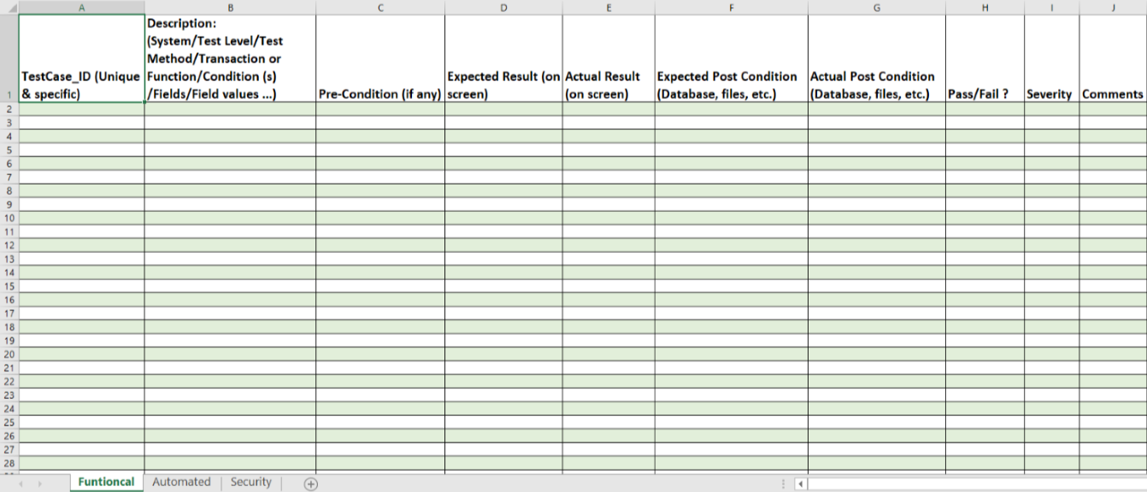
Test Results Capture

Slide 45
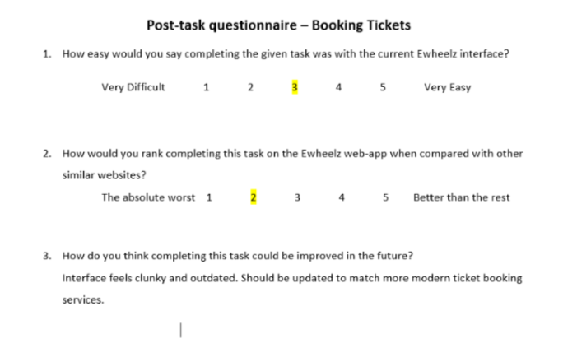
Test Results Capture

Slide 46
References
Dustini, E (2009) Implementing Automated Software Testing ,
.
STLC - Software Testing Life Cycle Phases & Entry, Exit Criteria Retrieved from: https://www.guru99.com/software-testing-life-cycle.html
Pexel. [Photograph]. (2019) Work photos. Retrieved from
https://www.pexels.com/search/work/
Rosenbaum, Sarah & Glenton, Claire & Cracknell, Jane. (2008).
User experiences of evidence-based online resources for health professionals: User testing of The Cochrane Library. BMC medical informatics and decision making. 8. 34. 10.1186/1472-6947-8-34.

Slide 47
Thank You

